Slide 1
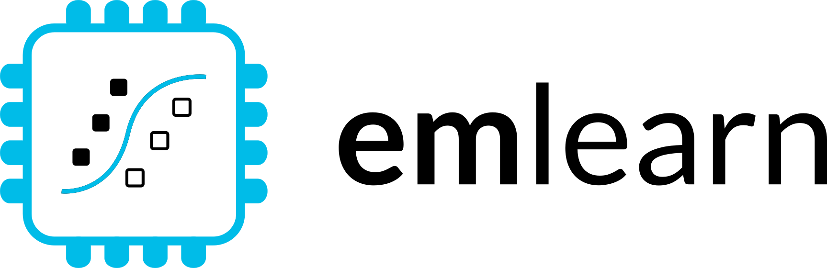

Machine Learning for Microcontrollers
Tiny, useful & fun
https://github.com/emlearn/emlearn
AiDev 2025, Amsterdam Jon Nordby jononor@gmail.com

Slide 2
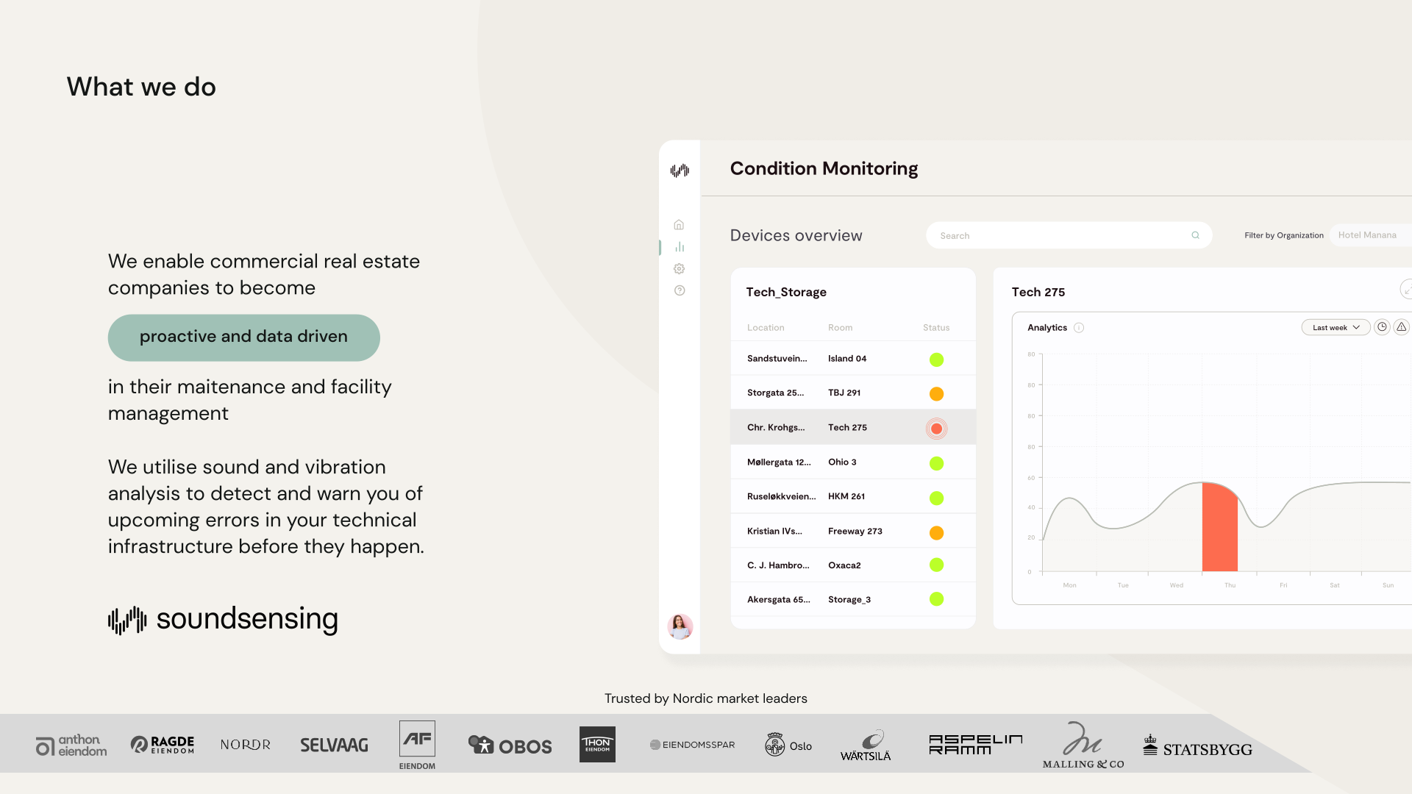
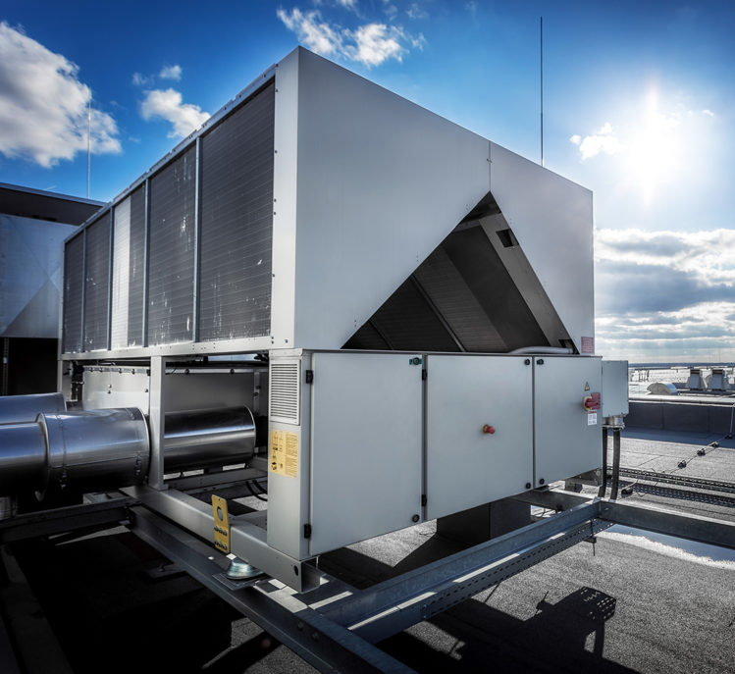
Notes:
Work as Head of Data Science at Soundsensing.
Soundsensing is a leading provider of predictive maintenance solutions for ventilation systems in buildings. So we work a lot with sensor data. And also use Python as much as we can for Data Science, IoT and backend tasks.

Slide 3

Outline / agenda
Why ML on microcontrollers (“TinyML”)
About the emlearn project
Projects made with emlearn
Quick how-to for emlearn
Bonus: Model optimization
Notes:
As a brief structure of this presentation

Slide 4
Introduction
How is machine learning relevant for constrained embedded devices and microcontrollers?

Slide 5
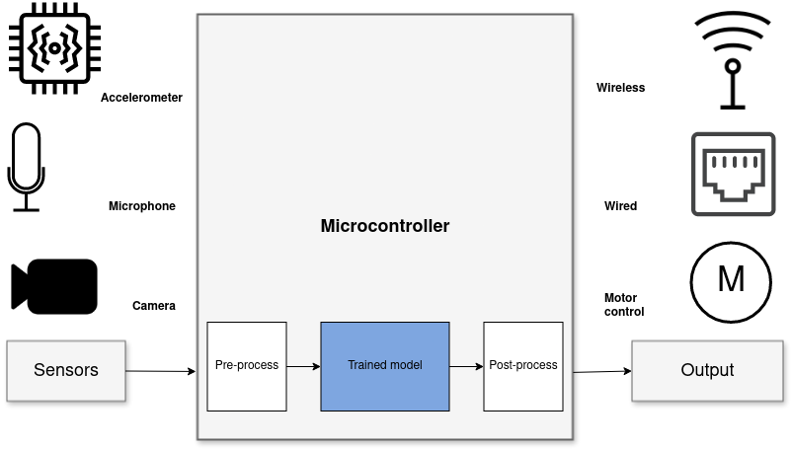
Sensor data analysis with Machine Learning
Benefits vs sending data to cloud
Stand-alone
Low latency
Power efficiency
Privacy
Low cost
System diagram for “TinyML” solution
Notes:
When it comes to Machine Learning on microcontrollers,
we are obviously not going to be running any Large Language Models or generative image models.
But one usecase where ML is incredibly useful is in analysing sensor data.
Sensors such as accelerometers, microphonones, radars, and cameras have gotten incredibly cheap and powerful.
But in order to get useful information out of these, the raw data must be processed.
Using Machine Learning, in combination with Digital Signal Processing, allows analyzing complex phenomena.
If this is done on the microcontroller, we get a range of benefits:
...
The component in blue is the Machine Learning model, and is typically trained ahead of time on a PC.

Slide 6
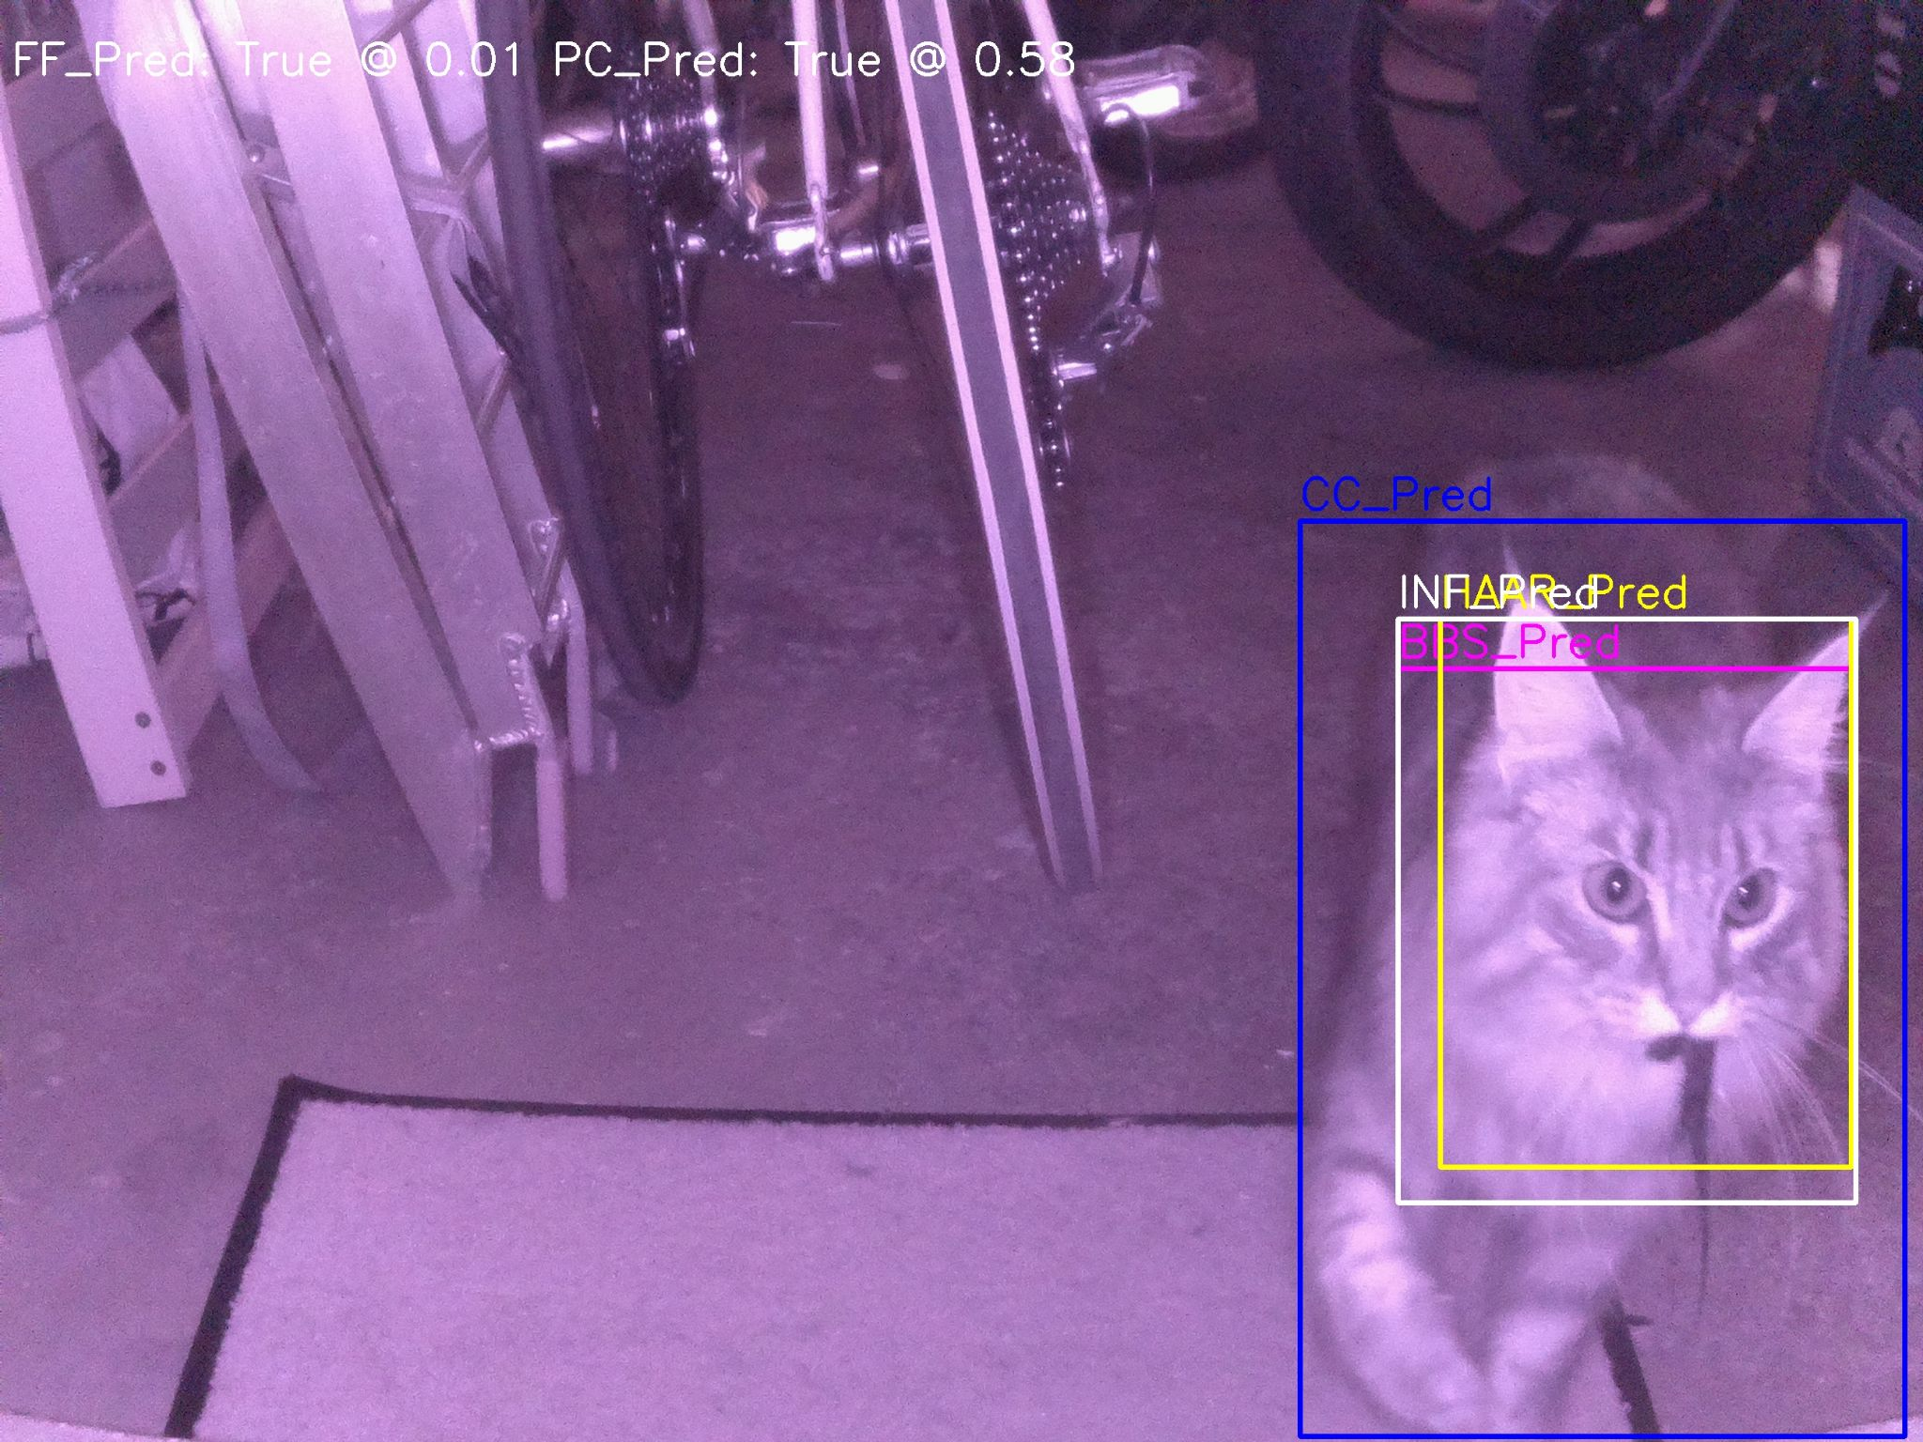
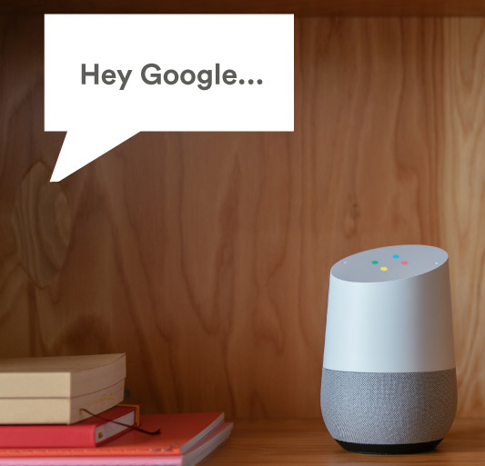
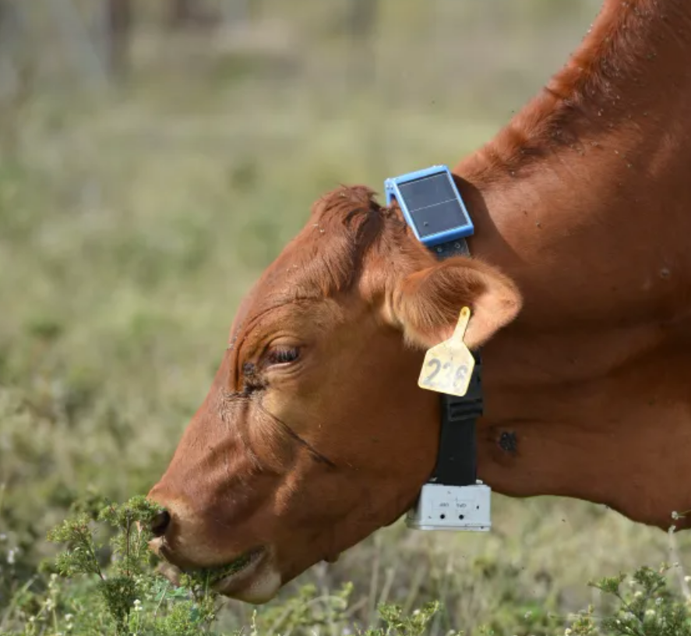
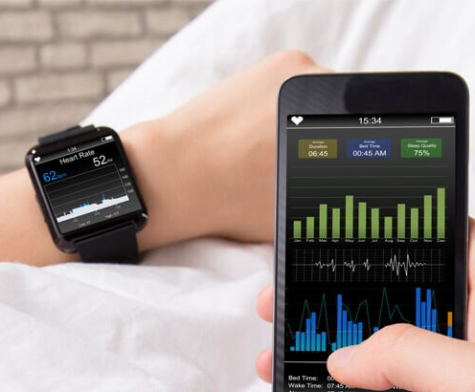
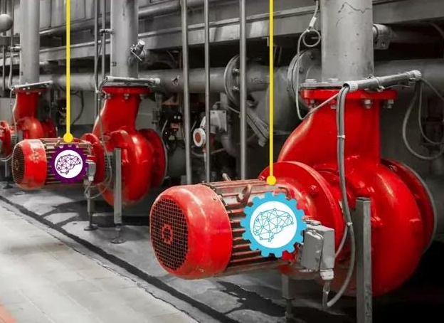
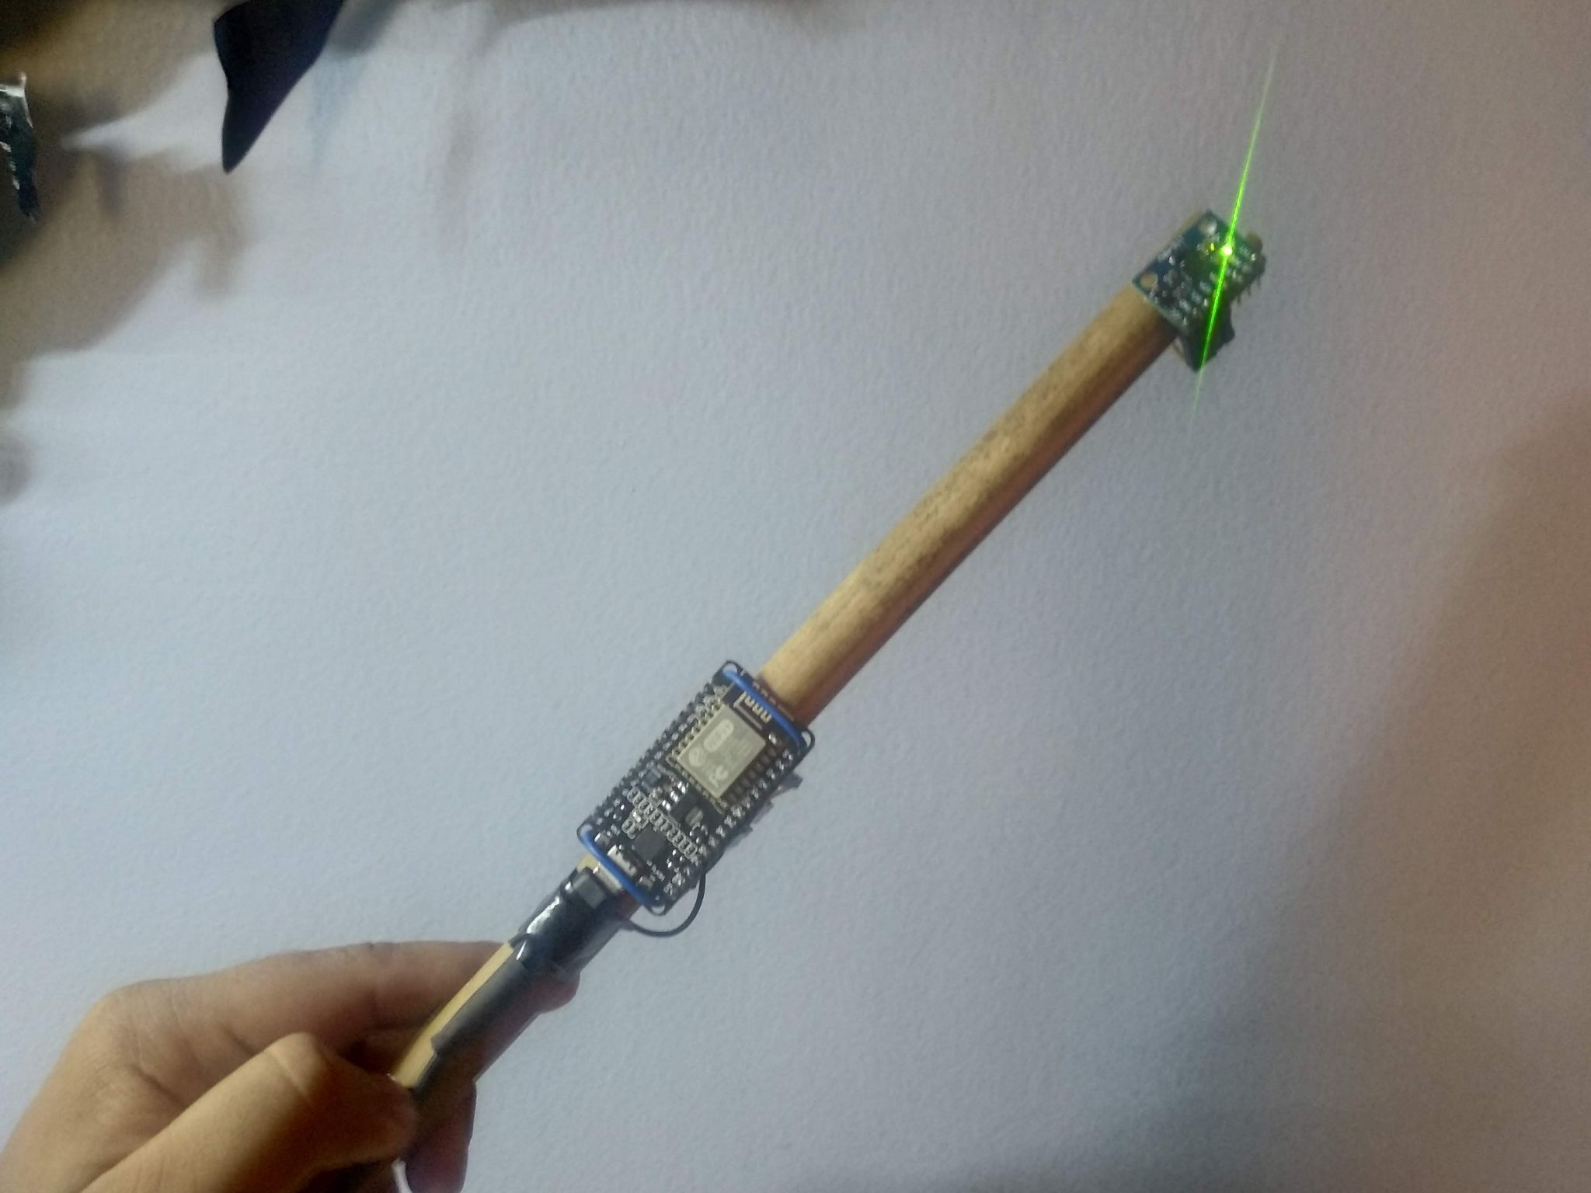
Applications
Consumer Tech
Industrial
Fun
Notes:
This is a huge amount of applications for this, in basically any field that uses electronics.
Keyword spotting / wakeword detection. “Alexa” Smartwatch. Sleep activity tracking Agriculture. Cattle activity tracking Condition monitoring of Machinery.
Or what about a cat doorbell that only lets in your cat, and only if it does not have a prey in its both. Magic wand.

Slide 7
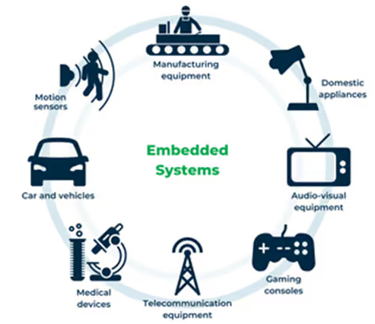
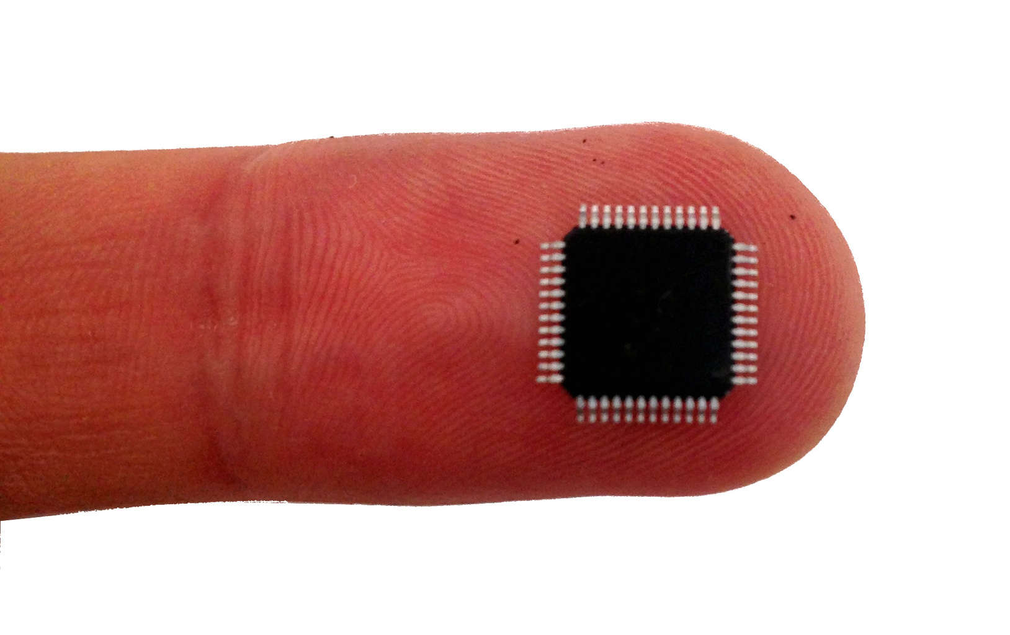
Microcontroller - tiny programmable chip
Compute power: 1 / 1000x of a smartphone
RAM: 0.10 - 1 000 kB
Program space: 1.0 - 10 000 kB
Compute 10 - 1000 DMIPS
Price: 0.10 - 10 USD
Over 20 billions shipped per year
Increasingly accessible for hobbyists
2010: Arduino Uno 2016: ESP32 2021: RP2040 2024: RP2350
Efficiency is key ! Memory, compute, power
Arduino IDE C/C++
MicroPython
Notes:
Microcontroller is a small programmable chip.
That since the last 20 years provides the “brain” of basically any electronics device around us.
All the devices that you have in your home have 1 or more microcontrollers each.
A modern car has over 50 microcontrollers.
While they are mostly used for industrial application, they are increasingly accessible for hobbyists and semi-professionals. And today many of these devices can run Python! So in a way, you probably already know how to program them.

Slide 8
About emlearn
Started in 2018
Open-source (MIT)

Slide 9





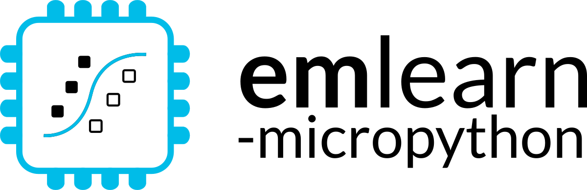





1. Train on PC
2. Deploy on device
pip install emlearn
Embedded Friendly
Portable C99 code
No dynamic allocations
Header-only
High test coverage
Integer/fixed-point math *
Small. 2 kB+ FLASH
Convenient training
Model creation in Python
Use standard libraries
scikit-learn
Keras
One-line to export to device
Verification tools included
Convenient & Efficient
Portable MicroPython
Single .mpy file
No dynamic allocations
High test coverage
Integer/fixed-point math *
Small. 2 kB+ FLASH
Notes:
emlearn is an open-source software library that can be used to implement such projects.
It provides embedded friendly implementations of Machine Learning models.
It supports converting models trained in Python.
Can either use scikit-learn or Keras.
The code is portable and clean C99.
It can be used on even the smallest MCUs,
as it does not need FPU, and the code size is very small.

Slide 10
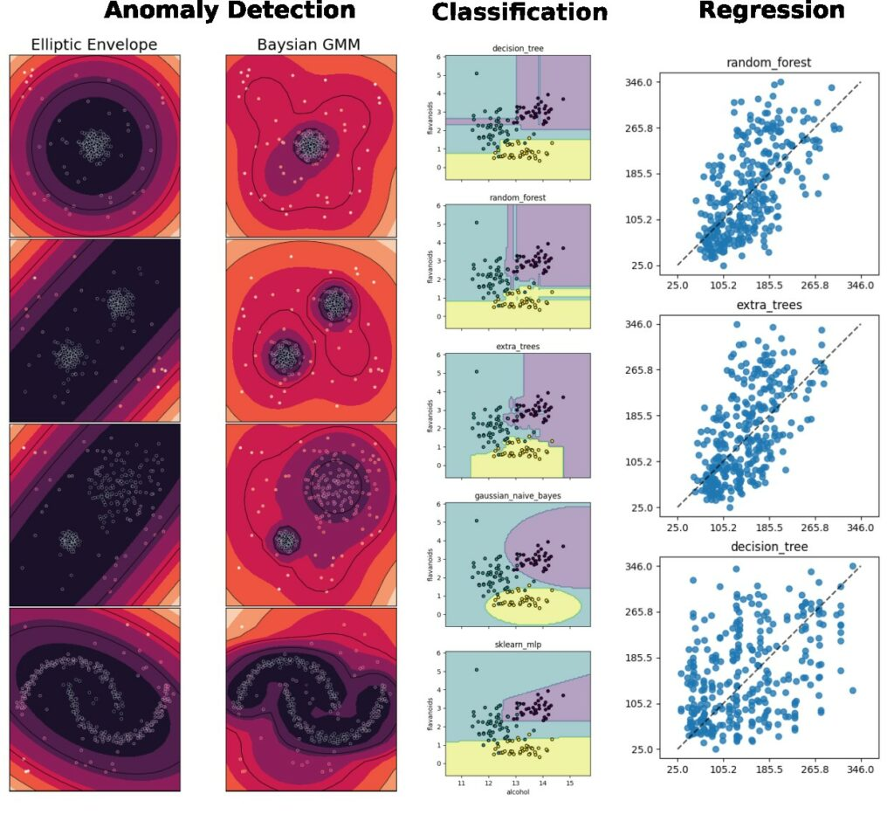
Supported tasks
Supports the most common tasks for embedded & sensor data use cases.
Classification
Regression
Anomaly Detection
Notes:
emlearn supports the three most common ML tasks:
classification, regression, anomaly detection.

Slide 11
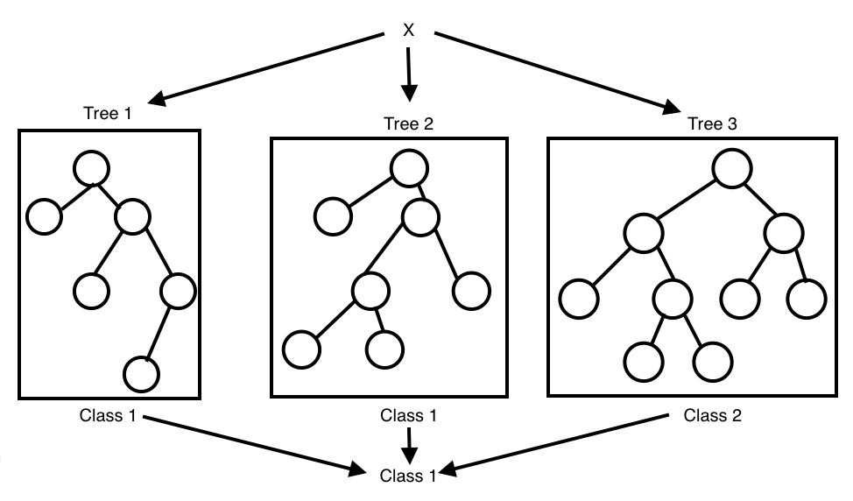
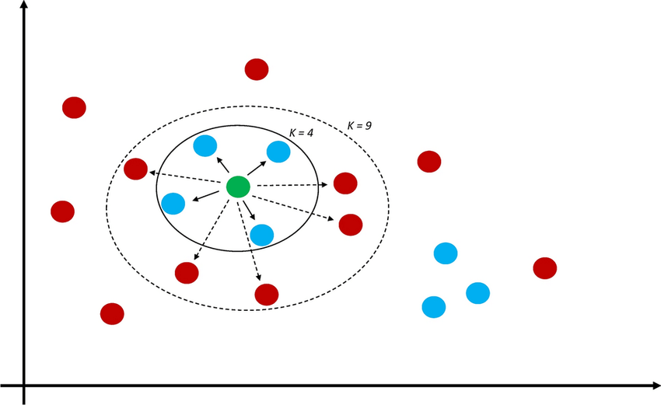
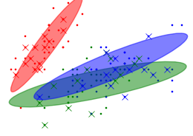
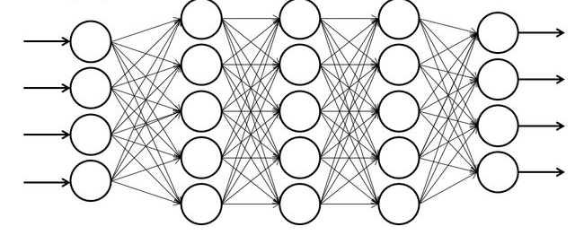
Supported models
Selection of simple & effective embedded-friendly models
Decision Trees (DT)
Random Forest (RF)
K Nearest Neighbors (KNN)
Gaussian Mixture Models (GMM)
Multi-Layer-Perceptron (MLP)
Convolutional Neural Network (CNN)
Notes:
Supports a selection of embedded friendly models:
….

Slide 12
Projects using emlearn
Many real-world uses across the globe
Referred in 40+ publications

Slide 13
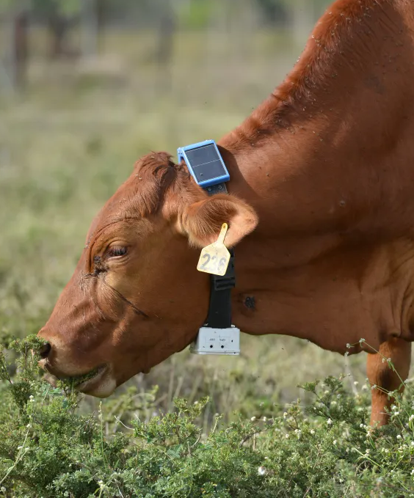
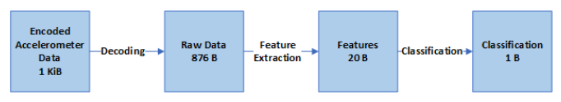

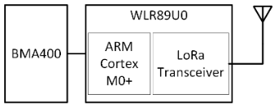
Health monitoring for cattle
Accelerometer data used to detect abnormal behavior. Can indicate health issues or other problems
Classified using a Decision Tree lying/walking/standing/grazing/ruminating Activity is transmitted using LoRaWAN
Running ML on-sensor: under 1 mW
50 times lower power than sending raw data
Power Efficient Wireless Sensor Node through Edge Intelligence
Abhishek Damle (2022)

Slide 14
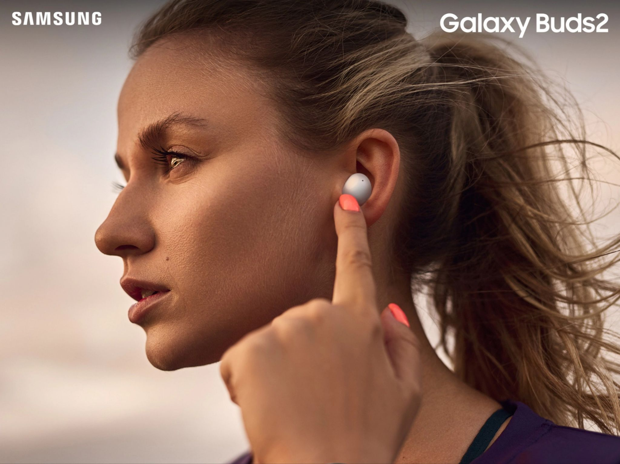
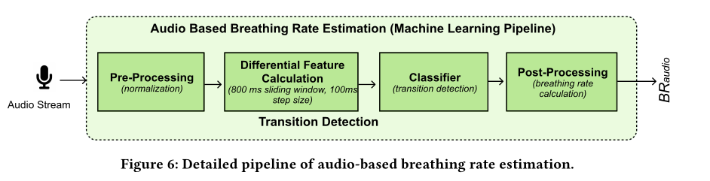
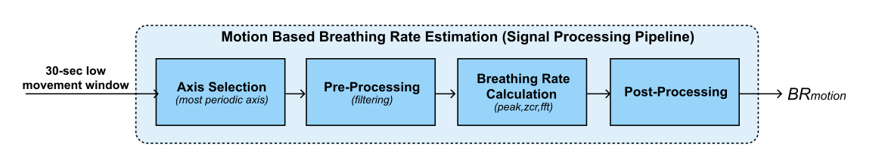
Health monitoring earable
Breathing rate is critical to monitor for persons with respiratory health problems.
Monitoring for every-day use, not just in clinical context. Using earable to replace specialized devices.
Random Forest classifier for audio.
Remote Breathing Rate Tracking in Stationary Position
Using the Motion and Acoustic Sensors of Earables
Tousif Ahmed et.al (2023)
Notes:
The project was started in 2018 by me.
And has been maintained by me since that time. With a couple of contributors here and there. Quite mature. Has been used for dozens of projects across the world.

Slide 15
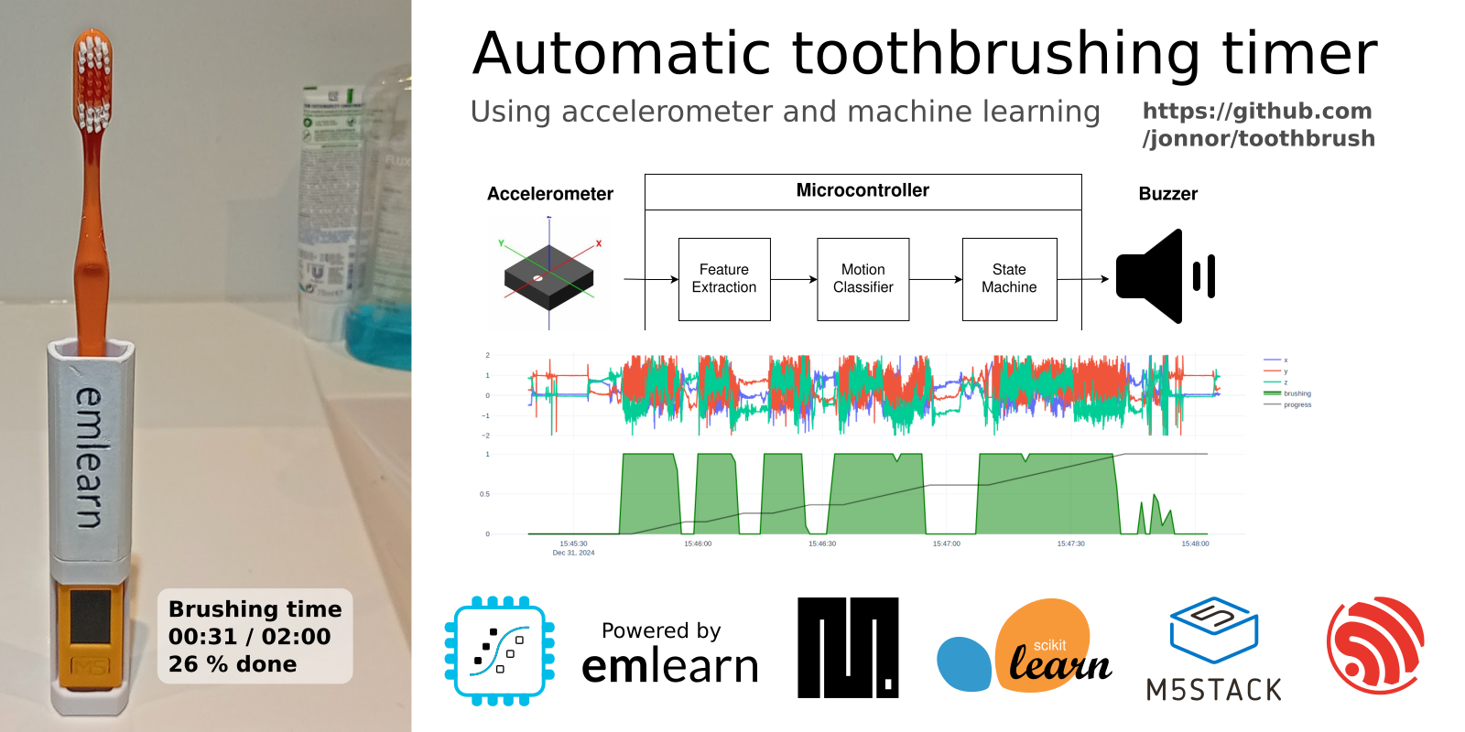
Automatic toothbrush timer
https://github.com/ jonnor/toothbrush/
Stock hardware: M5StickC PLUS 2 by M5Stack
~500 lines of MicroPython code
Collected and labeled data in ~1 hour
Data collection and training tools: https://github.com/emlearn/emlearn-micropython/tree/master/examples/har_trees

Slide 16
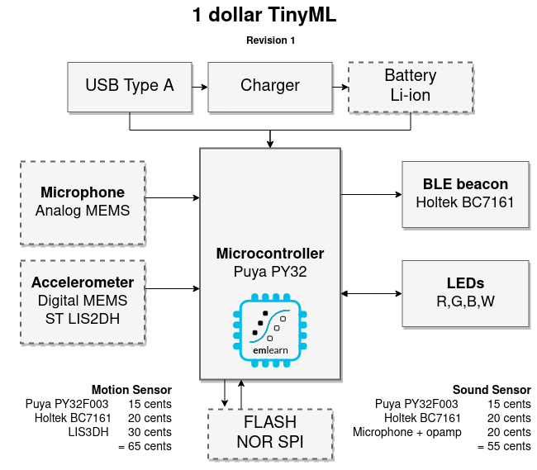
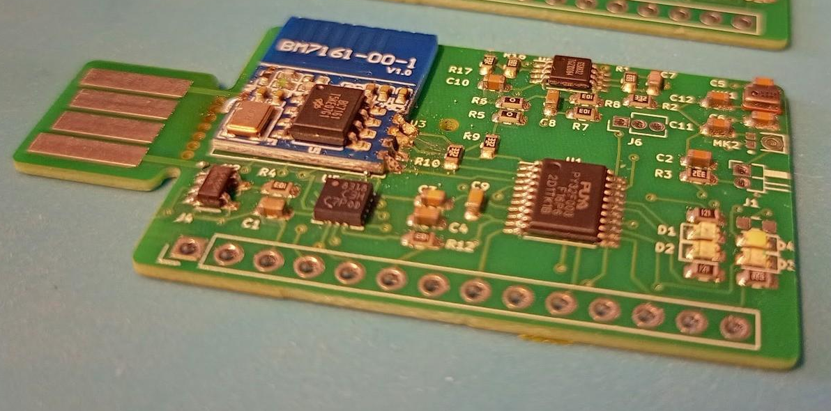
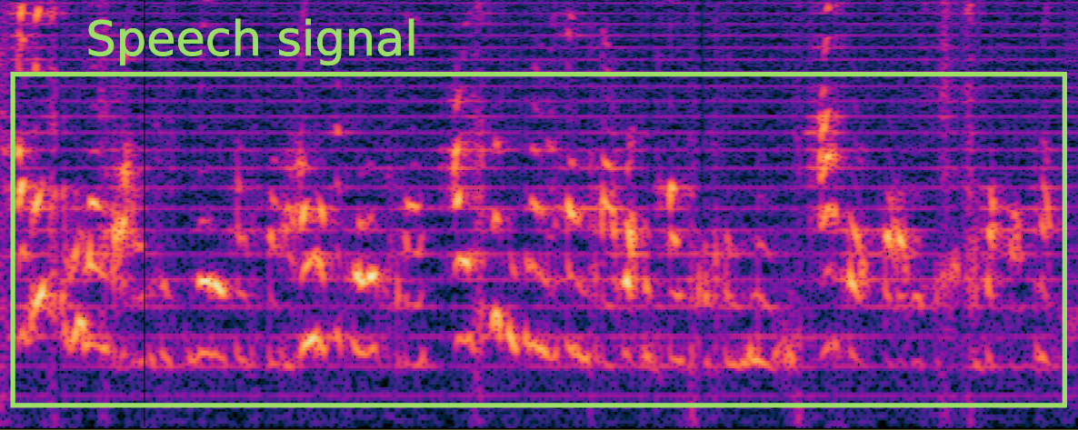
1 dollar TinyML
https://hackaday.io/project/194511-1-dollar-tinyml
Research question: Can we make a useful TinyML system <1 USD in total component cost (BOM)?
Preliminary answer: YES! Either motion (accelerometer) or sound sensor (microphone)
Constraints: 8 kB RAM / 64 kB FLASH
Current status: Audio streaming works Revision 2 ordered
A)
B)
Notes:
### Object detection

Slide 17
emlearn for C
Quick walkthrough

Slide 18
Train and export a model
Train using standard Python ML libraries.
from keras import …
model = Sequential([
Dense(16, input_dim=n_features, activation='relu'),
Dense(8, activation='relu'),
Dense(1, activation='sigmoid'),
])
model.compile(....)
model.fit(X_train, Y_train, epochs=1, batch_size=10)
keras neural network
from sklearn.neural_network import MLPClassifier
model = MLPClassifier(hidden_layer_sizes=(100,50,25))
model.fit(X_train, Y_train)
B) scikit-learn neural network
#include <eml_net.h>
static const float mynet_layer_0_biases[8] = { -0.015587f, -0.005395f, -0.010957f, 0.015883f ….
static const float mynet_layer_0_weights[24] = { -0.256981f, 0.041887f, 0.063659f, 0.011013f, …
static const float mynet_layer_1_biases[4] = { 0.001242f, 0.010440f, -0.005309f, -0.006540f };
static const float mynet_layer_1_weights[32] = { -0.577215f, -0.674633f, -0.376140f, 0.646900f, …
static float mynet_buf1[8];
static float mynet_buf2[8];
static const EmlNetLayer mynet_layers[2] = {
{ 8, 3, mynet_layer_0_weights, mynet_layer_0_biases, EmlNetActivationRelu },
{ 4, 8, mynet_layer_1_weights, mynet_layer_1_biases, EmlNetActivationSoftmax }
};
static EmlNet mynet = { 2, mynet_layers, mynet_buf1, mynet_buf2, 8 };
int32_t
mynet_predict(const float *features, int32_t n_features)
{
return eml_net_predict(&mynet, features, n_features);
}
………
2. Use emlearn.convert() and .save()
import emlearn
cmodel = emlearn.convert(model, method='inline')
cmodel.save(file=mynet_model.h', name='mynet')
Example of generated code
Notes:
Training a model is done using a standard framework like scikit-learn or keras.
You will need to already have a dataset collected and labeled for your task.
There is nothing emlearn specific at this point
- although you should use a model small enough to fit on your target device.
We also provide some tools for checking this.
Once you have a trained model, you are ready to deploy it to the device.

Slide 19
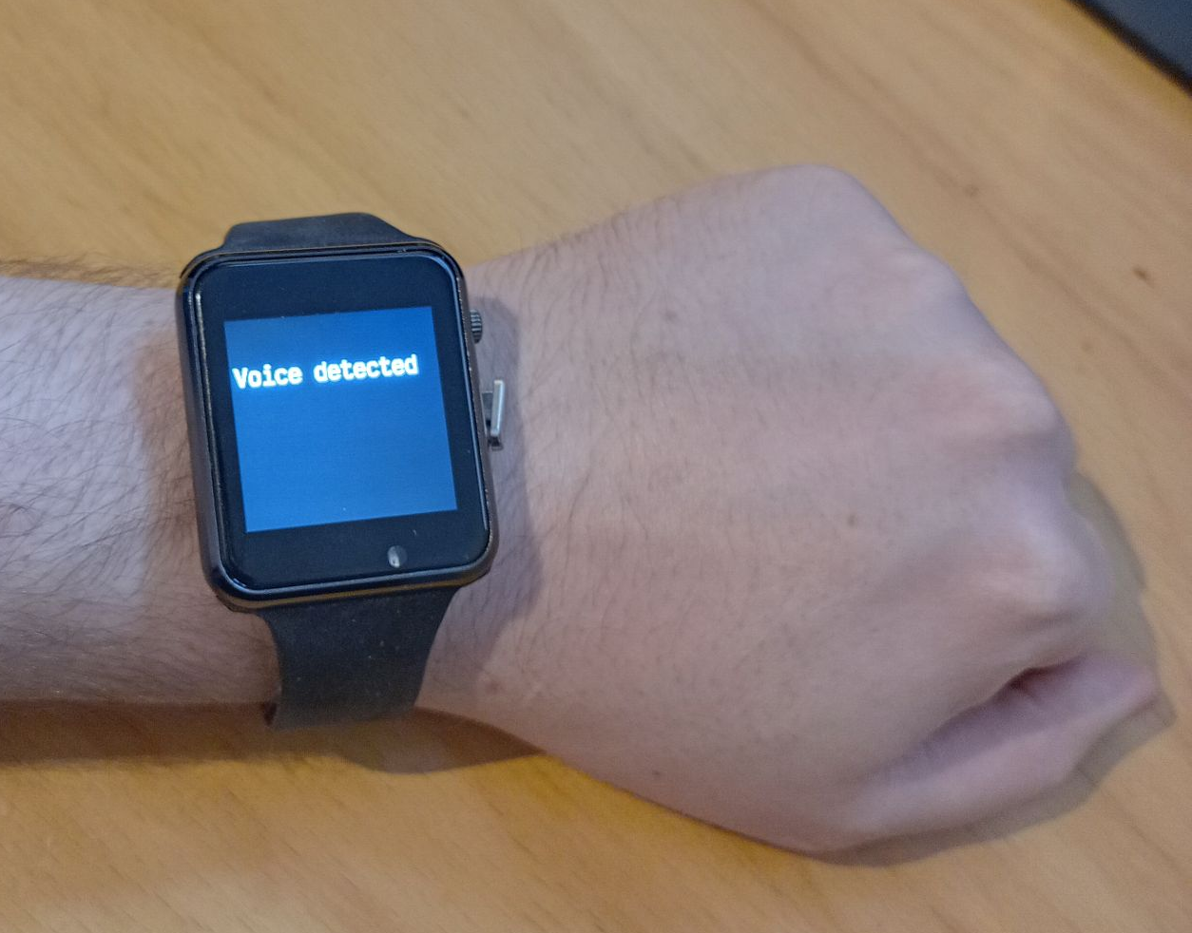
Using the C code
3. #include and call predict()
// Include the generated model code
#include "mynet_model.h"
// index for the class we are detecting
#define MYNET_VOICE 1
// Buffers for input data
#define N_FEATURES 6
float features[N_FEATURES];
#define DATA_LENGTH 128
int16_t sensor_data[DATA_LENGTH];
// Get data and pre-process it
read_microphone(sensor_data, DATA_LENGTH);
preprocess_data(sensor_data, features);
// Run the model
out = mynet_predict(features, N_FEATURES);
// Do something with results
if (out == MYNET_VOICE) {
set_display("voice detected");
} else {
set_display("");
}
setup
loop
Notes:
To use the code, include the generated header file.
Pass the data to the predict() call of the model.
The output can the be used to trigger relevant actions,
such as controlling motors, logging event that occur,
or sent an external system.
In this example, we just show the model output on a display.

Slide 20
emlearn for MicroPython
Python is the lingua franca for Machine Learning How can we enable people to build TinyML solution also using Python?

Slide 21
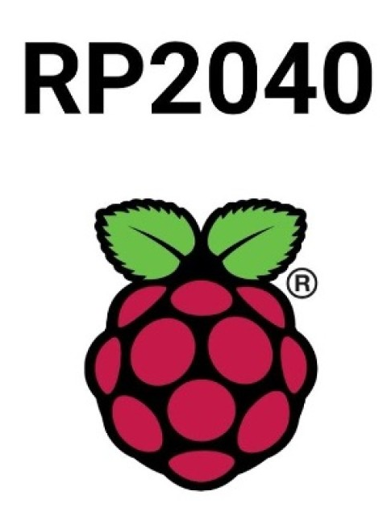

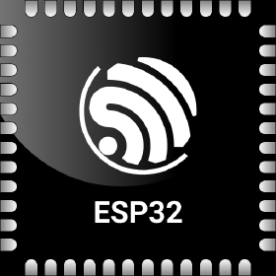
MicroPython - Introduction
Implements a subset of Python 3.x
For devices with 16 kB+ RAM
Supports 8+ microcontroller families
As compatible with CPython as possible, within constraints. No CFFI or C module compatibility! TLDR: Small .py scripts will mostly work with minor mods But not PyData stack
“mip” package manager Can load C modules at runtime!
More info: https://micropython.org
Notes:
STM32, Nordic NRF5x, ESP32, RP2040

Slide 22
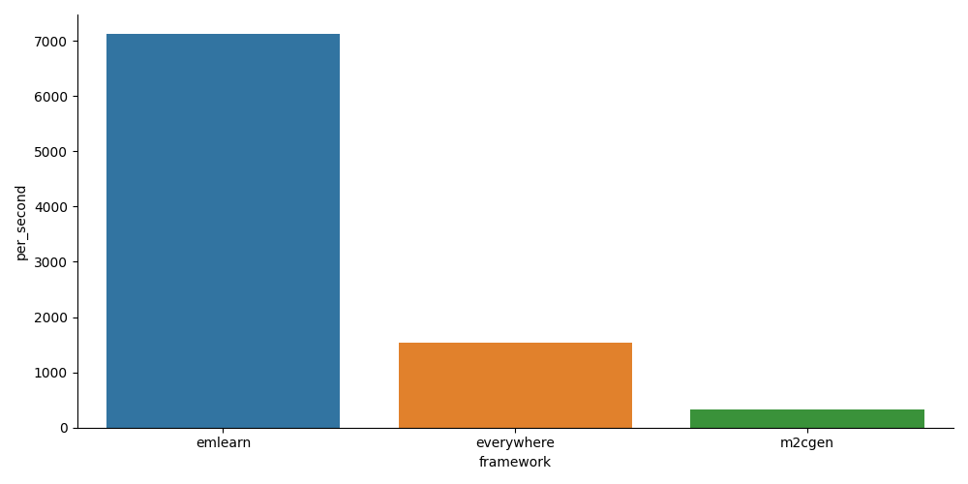
MicroPython library for emlearn
Combine the convenience, familiarity and productivity of Python - with the speed of C
Modules installable at runtime (.mpy)
5x - 20x faster than plain Python
emlearn_iir Infinite Impulse Response filters emlearn_trees Random Forest emlearn_fft Fast Fourier Transform emlearn_cnn Convolutional Neural Networks Image classification+ emlearn_neighbors K-nearest Neighbors On-device learning
https://github.com/emlearn/emlearn-micropython/

Slide 23
Install & Export model
import emlearn
estimator = train_model()
converted = emlearn.convert(estimator)
converted.save(name='gesture', format=’csv’, file='gesture_model.csv')
Export model on PC
Copy model to device
mpremote fs cp gesture_model.csv :
Prebuilt binary No need to setup C toolchain and SDK
Copy library to device
mpremote mip install https://emlearn.github.io/...../xtensawin_6.2/emltrees.mpy

Slide 24
Load model & run
import emltrees
# Instantiate model. Capacity for trees, decision nodes, classes
model = emltrees.new(20, 200, 10)
# Load model "weights"
with open('gesture_model.csv') as f:
emltrees.load_model(model, f)
Load model on device
# Read sensor data
sensor.fifo_read(samples)
# Preprocess features
preprocessor.run(samples, features)
# Run model
out = model.predict(features)
Run inference

Slide 25
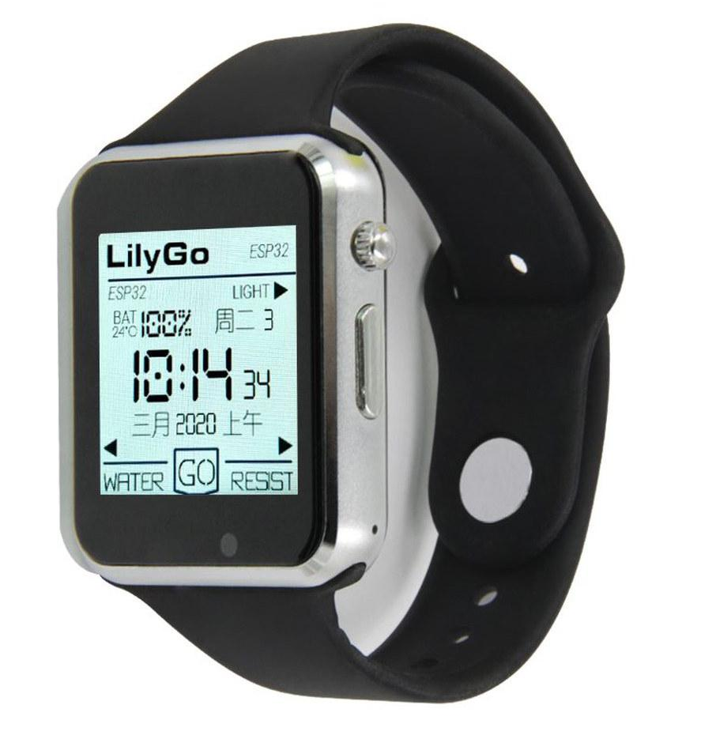
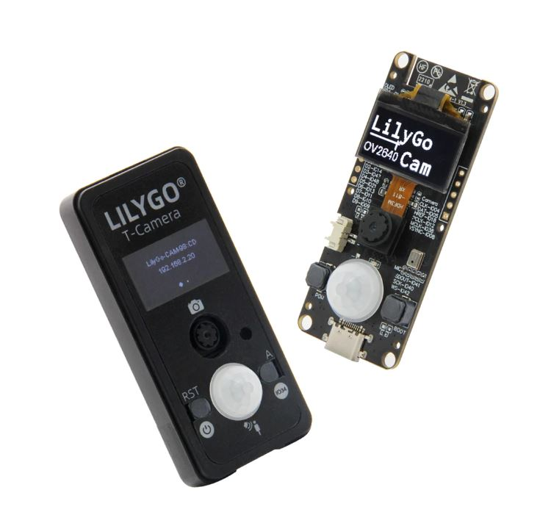

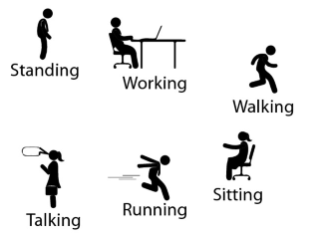
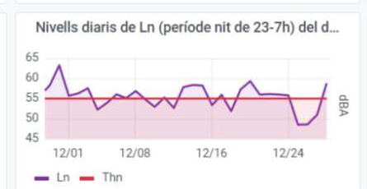
Activity tracker
Noise monitor
Image
Classifier
Accelerometer
Microphone
Camera
Examples at
https://github.com /emlearn/emlearn-micropython #examples
if is_MyCat(img): open_door()
Random Forest classifier emlearn_trees
Infinite Impulse Response filters emlearn_iir
Convolutional Neural Network emlearn_cnn

Slide 26
Outro

Slide 27
Summary
Machine Learning used in embedded systems to automatically analyze sensor data
Practical applications possible with just a kilo-bytes RAM, milli-watts of power, couple dollars
emlearn is an open-source project to help deploy ML models to microcontrollers - running C or MicroPython
Notes:
As a brief structure of this presentation

Slide 28
More resources
Official documentation https://emlearn-micropython.readthedocs.io https://emlearn.readthedocs.io
PyCon Berlin 2024: Machine Learning on microcontrollers using MicroPython and emlearn https://www.youtube.com/watch?v=S3GjLr0ZIE0 TinyML EMEA 2024: emlearn - scikit-learn for microcontrollers and embedded systems https://www.youtube.com/watch?v=LyO5k1VMdOQ
PyData ZA 2024: Sensor data processing on microcontrollers with MicroPython https://za.pycon.org/talks/31-sensor-data-processing-on-microcontrollers-with-micropython/
Notes:
Microcontroller is a small programmable chip.
That since the last 20 years provides the “brain” of basically any electronics device around us.
All the devices that you have in your home have 1 or more microcontrollers each.
A modern car has over 50 microcontrollers.
While they are mostly used for industrial application, they are increasingly accessible for hobbyists and semi-professionals. And today many of these devices can run Python! So in a way, you probably already know how to program them.

Slide 29
Machine Learning for Microcontrollers
Tiny, useful & fun
https://github.com/emlearn/emlearn
AiDev 2025, Amsterdam Jon Nordby jononor@gmail.com

Slide 30
Bonus

Slide 31
Model optimization
https://emlearn.readthedocs.io/en/latest/model_optimization.html
https://emlearn.readthedocs.io/en/latest/tree_based_models.html

Slide 32
Compute constraints
RAM
64 kB
Reserved
FLASH
512 kB
Reserved
ML pipeline
Post-processing
Post-processing
Memory (RAM)
Program space (FLASH)
Inference time (CPU)
Energy (battery)
Model
Model
Pre-processing
Pre-processing
Sensor reading
Sensor reading
System/ Application
User interface
Drivers
Drivers
CPU
Cortex M4F
User interface
Connectivity
Connectivity
Active time
Send
Send
Sleep zzzzZZZ
Energy
Total time
Time
Notes:
Inline and loadable (data structure) Majority voting instead of class probabilities Leaf-node de-duplication

Slide 33
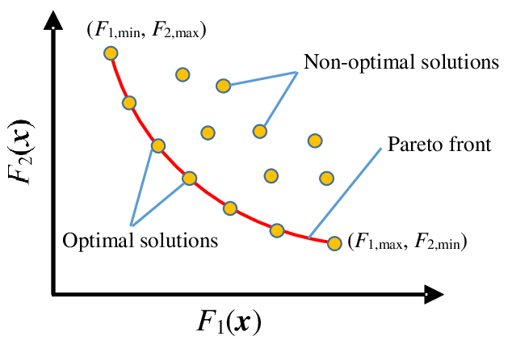
Pareto front - performance/compute tradeoffs
Many possible combinations of predictive performance vs computational cost
No point considering the non-optimal solutions!
Pareto front is formed by the set of optimal solutions - that dominate the non-optimal ones
Describes the possible tradeoffs between predictive performance and compute
Utilities for finding Pareto front in emlearn.evaluate.pareto https://emlearn.readthedocs.io/en/latest/evaluate.html Example: https://emlearn.readthedocs.io/en/latest/auto_examples/trees_hyperparameters.html
Notes:
Inline and loadable (data structure) Majority voting instead of class probabilities Leaf-node de-duplication

Slide 34
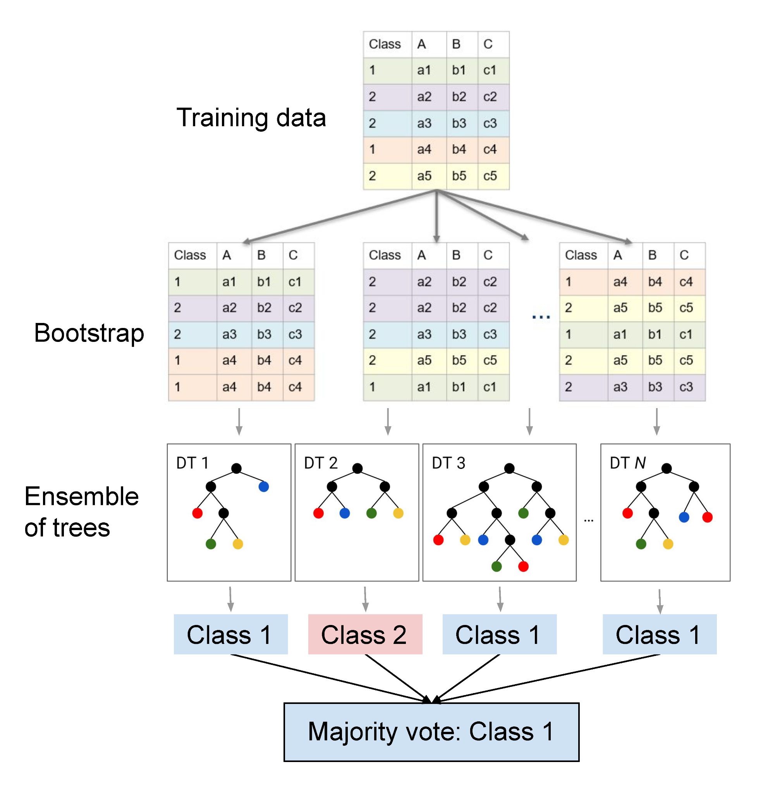
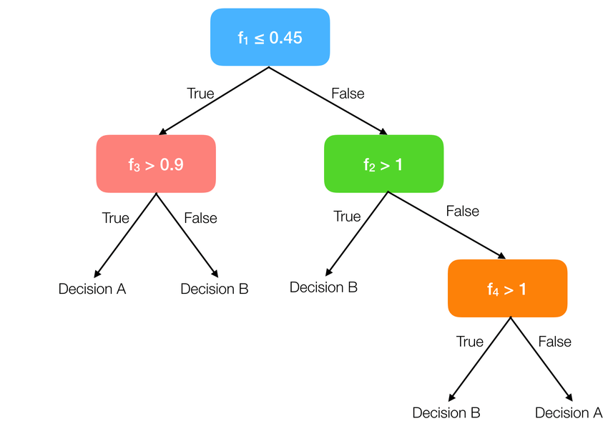
How tree-ensemble models work

Slide 35
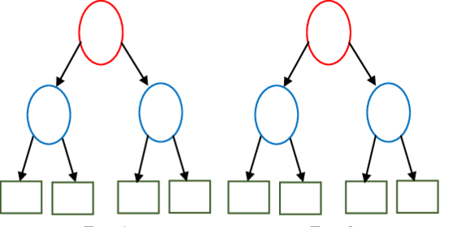
Tree-based ensembles - costs
Input features, length F [ 0.23, 0.56, 0.11, 0.55 ]
IF features[2] < 0.74 THEN next=left ELSE next=right
Depth D
Tree 1
Tree 2
No. features F [0]
No. trees T
Tree Depth D_max [1] / D_eff [2]
No. nodes N ≈ T * (2 ** D)
Computational costs
Memory (RAM) O(F)
Program (FLASH) O(N) [3]
Exc. time (CPU) sum(D_eff(t), t -> T)
[0] May also enable deeper trees
[1] Depth might differ across trees [2] Execution path is data dependent! Can estimate average using a dataset, or worst-case from model [3] Assuming leaf and decision nodes same size
cl1
cl2
Utilities for estimating costs
from emlearn.evaluate.trees import model_size_bytes, compute_cost_estimate
Notes:
Inline and loadable (data structure) Majority voting instead of class probabilities Leaf-node de-duplication

Slide 36
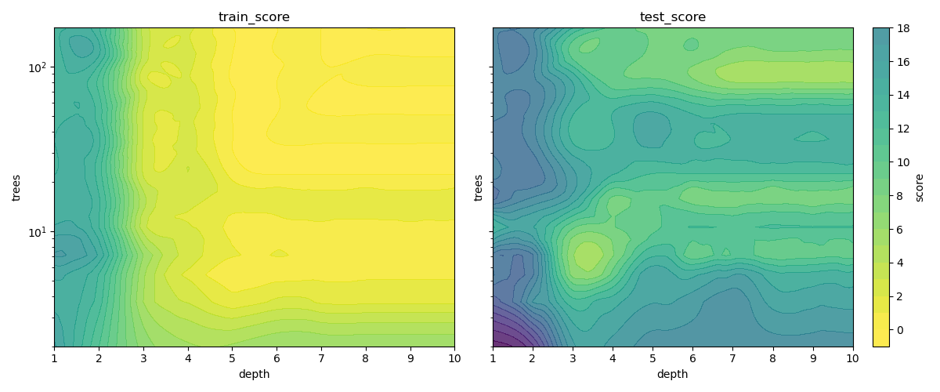
Tree-based ensemble - predictive performance
No. features F increases capacity
No. trees T increases capacity, decreases overfitting
Tree Depth D_max / D_eff increases capacity, increases overfitting
No. nodes N ≈ T * D
For generalized performance (on unseen data), need to balance overfitting.
Notes:
Inline and loadable (data structure) Majority voting instead of class probabilities Leaf-node de-duplication

Slide 37
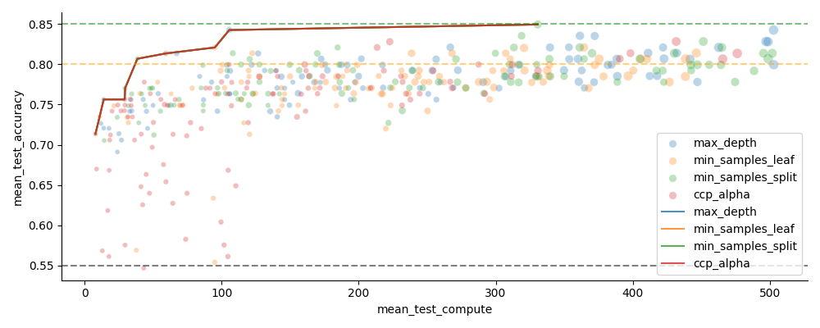
Hyperparameter tuning with scikit-learn
Vary n_estimators (trees) and one of the depth limiting hyperparameters
from sklearn.model_selection import GridSearchCV, RandomizedSearchCV
https://emlearn.readthedocs.io/en/latest/auto_examples/trees_hyperparameters.html
Notes:
Inline and loadable (data structure) Majority voting instead of class probabilities Leaf-node de-duplication

Slide 38
emlearn trees: Inference modes
Data structure (“loadable”)
Can be loaded at runtime
Only supports float
Code generation (“inline”)
Supports int8/int16/int32 and float
static const EmlTreesNode xor_model_nodes[14] = {
{ 1, 0.197349f, 1, 2 },
.........
{ 0, 0.421164f, -2, -1 }
};
EmlTrees xor_model = { 14, xor_model_nodes, …… };
static int32_t
eml_trees_predict_tree(const EmlTrees *f, int32_t tree_root,
const float *features, int8_t features_length) {
int32_t n = tree_root;
while (n >= 0) {
const float value = f[forest->nodes[node_idx].feature];
const float point = forest->nodes[node_idx].value;
const int16_t child = (value < point) ? f->nodes[n].left : f->nodes[n].right;
…..
}
return leaf;
}
static inline int32_t xor_model_tree_0(const float *features, int32_t features_length)
{
if (features[1] < 0.197349f) {
if (features[0] < 0.466316f) {
return 0;
} else {
return 1;
}
} else {
if (features[1] < 0.256702f) {
if (features[0] < 0.464752f) {
return 0;
} else {
return 1;
}
} else {
....
}
Notes:
16 bit integer features instead of 32 bit floats Reduced
Class probability leaves with clustering K-means

Slide 39
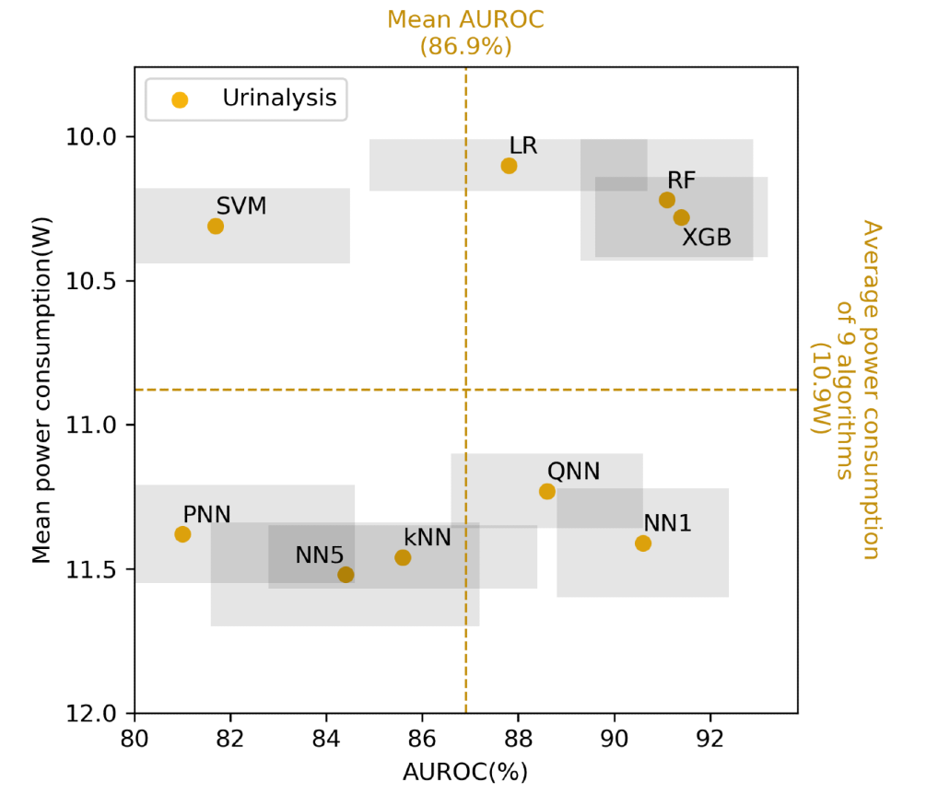
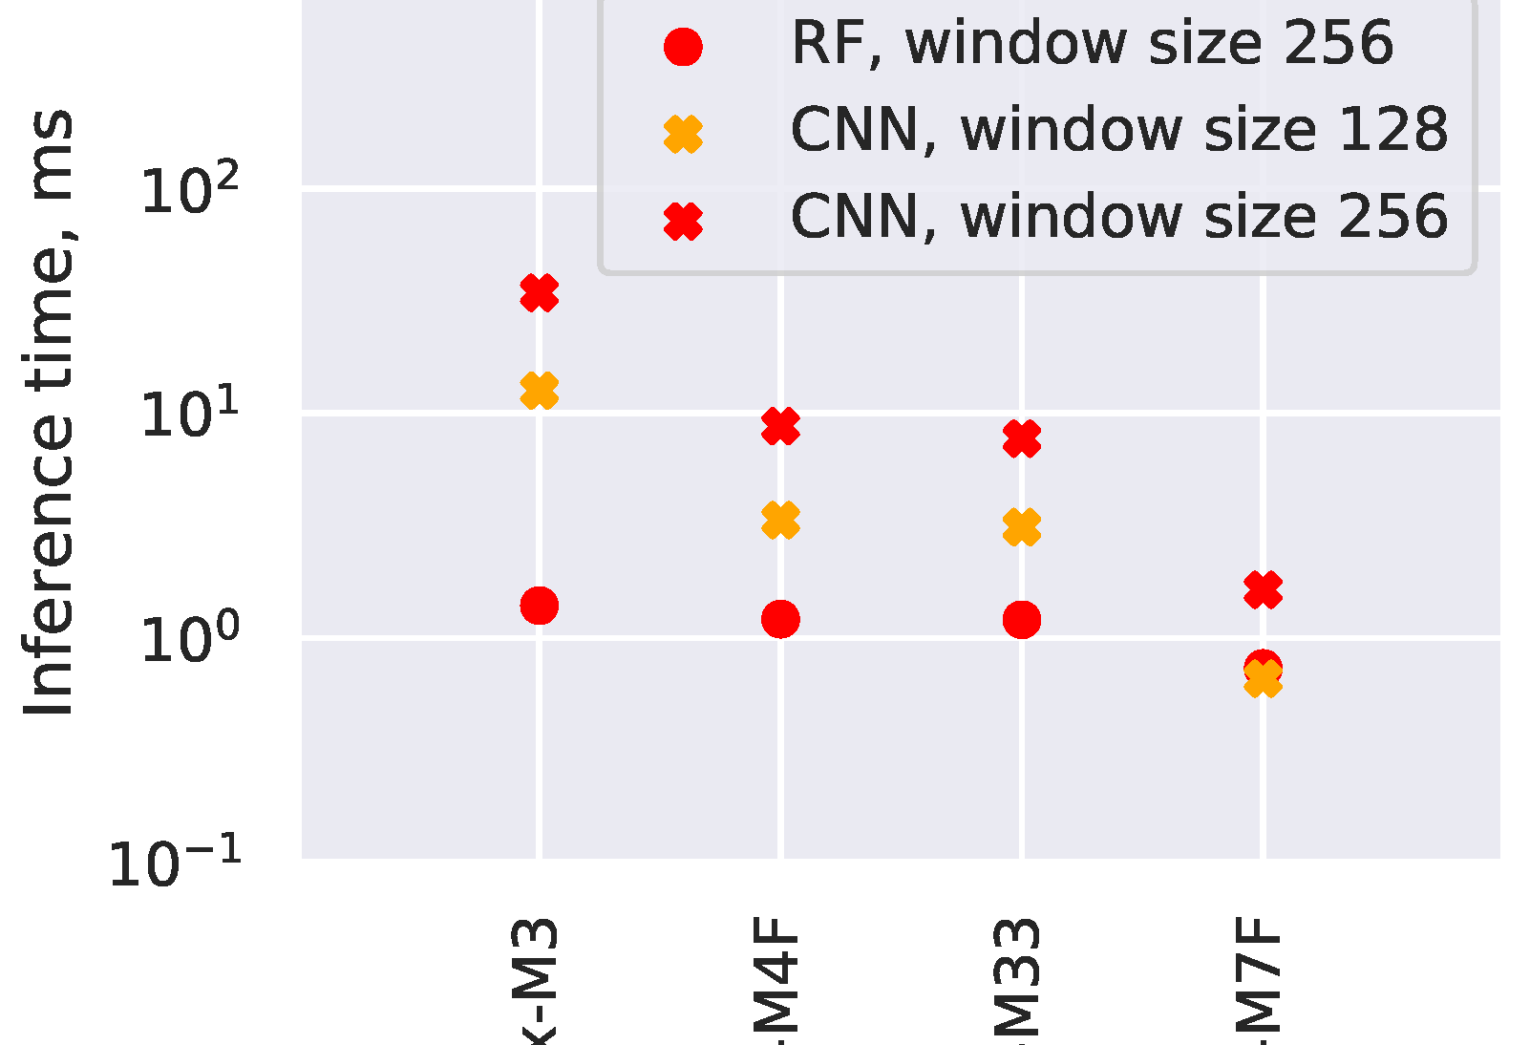
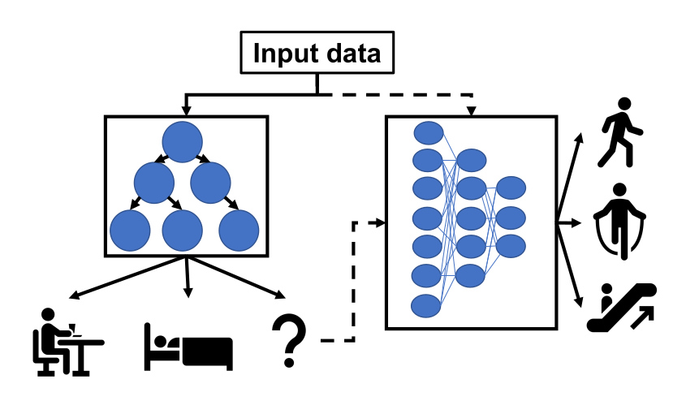
Trees - relevant across the task complexity range
Low Go-to for tabular data
Very easy to get good performance, with minimal tweaking.
Medium Alternative to deep learning
Elsts et.al [1] showed performance matching a deep-learning approach,
at 10x to 100x better resource usage
High Combine with neural network Daghero et.al [2] showed up to 67.7% energy saving using two-stage approach
1. “Are Microcontrollers Ready for Deep Learning-Based Human Activity Recognition?” Atis Elsts, Ryan McConville (2021) https://www.mdpi.com/2079-9292/10/21/2640
2. “Two-stage Human Activity Recognition on Microcontrollers with Decision Trees and CNNs”. Francesco Daghero, Daniele Jahier Pagliari, Massimo Poncino (2022) https://arxiv.org/abs/2206.07652 3. “Energy Efficiency of Inference Algorithms for Clinical Laboratory Data Sets: Green Artificial Intelligence Study”
Jia-Ruei Yu et. al (2022) https://www.jmir.org/2022/1/e28036/
Notes:
The project was started in 2018 by me.
And has been maintained by me since that time. With a couple of contributors here and there. Quite mature. Has been used for dozens of projects across the world.

Slide 40
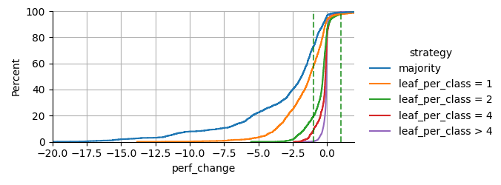
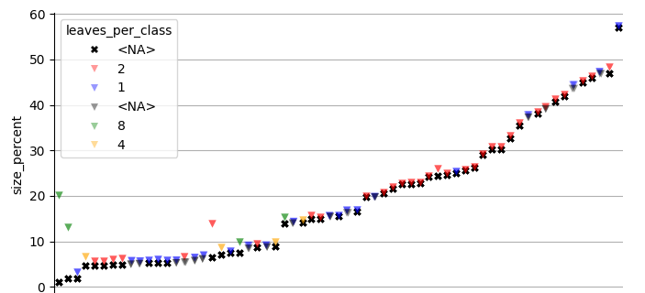
emlearn trees: K-means clustering for leaf de-duplication
Optimizing for: Small model size
Constraint: Under 1 percentage point drop in AUC ROC
Evaluating on 48 datasets from OpenML CC18 suite
Preliminary results - paper to follow
Hard majority sometimes bad:
Failed perf constraint on
75% of datasets
Clustering with N leaves per class Allows adaptable size/perf tradeoff
2-8 leaves per class sufficient 0% of datasets failed performance constraint
High model size compression 50-90%
Notes:
Inline and loadable (data structure) Majority voting instead of class probabilities Leaf-node de-duplication

Slide 41
Bonus

Slide 42
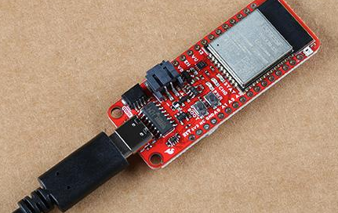
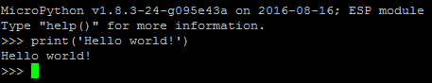
MicroPython - Installing
Download prebuilt firmware https://micropython.org/download/?port=esp32
Flash firmware to device
pip install esptool
esptool.py --chip esp32 --port … erase_flash
esptool.py --chip esp32 --port … write_flash -z 0 micropython-v1.17.bin
Connect to device
pip install mpremote mpremote repl
IDE (optional): Thonny, VS Code, et.c.
Notes:
! drives for peripherals that are on a board not included in core firmware
Will likely need to hunt a bit for each sensor, screen etc

Slide 43
TinyML for MicroPython - comparisons
Project | Deployment | Models | Program size | Compute time
emlearn | Easy. Native mod .mpy | DT, RF, KNN, CNN | Good | Good
everywhereml | Easy. Pure Python .py | DT, RF, SVM, KNN, | High with large models | Poor
m2cgen | Easy. Pure Python .py | DT, RF, SVM, KNN, MLP | High with large models | Poor
OpenMV.tf | Hard. Custom Fork | CNN | High initial size | Good
ulab | Hard. User C module | (build-your-own) Using ndarray primitives | High initial size | Unknown (assume good)
Notes:
Benchmark vs other MicroPython approaches

Slide 44
Task feasibility versus microcontroller type
 | RAM (kB) | FLASH (kB) | CPU (CoreMark) |  | IMU 100 hz 5 s | Sound 16 kHz 1 s | Image 64x64 px 1 fps
Arduino Uno ATMega 328 @ 16 Mhz | 2 | 32 | 4.0 |  | ✓ | ❌ | ❌
Arduino Nano BLE 33 NRF52840 ARM Cortex M4F @ 64 Mhz | 256 | 1 000 | 215 |  | ✓ | ✓ | ❌
Arduino Nano ESP32 ESP32-S3 @ 240 Mhz | 8 000 | 16 000 | 613 (per core) |  | ✓ | ✓ | ✓
Teensy 4.0 ARM Cortex M7 @ 600 Mhz | 1 000 | 2 000 | 2313 (per core) |  | ✓ | ✓ | ✓
Notes:
Coremark Mega 7.03 https://github.com/PaulStoffregen/CoreMark https://www.eembc.org/coremark/scores.php
Accelerometers/IMU 100-1kHz. Every N seconds. Human Activity Detection Basically anything ?
Sound
Typ 16 khz. Not 48 kHz
Specialized detectors. 1-100 classes
Image/video.
Low resolution, low framerate.
Specialized detectors. 1-10 classes. Not ImageNet Classification and object detection. Edge Impulse FOMO OpenMV
https://docs.edgeimpulse.com/docs/edge-impulse-studio/learning-blocks/object-detection/fomo-object-detection-for-constrained-devices

